Slide 1

R.M.K COLLEGE OF ENGINEERING AND TECHNOLOGY
FAKE NEWS DETECTION USING MACHINE LEARNING ALGORITHMS
MENTOR:
Mr. V. M Jemin M.E,(Ph.D)
TEAM MEMBERS:
Bogapathi Indrasena
Bhumana Sarath
Avinash Durai

Slide 2

ABSTRACT
The aim of this project is to build a precise model for fake news detection.
The advent of the World Wide Web and the rapid adoption of social media platforms paved the way for information dissemination that has never been witnessed in the human history before.
With the current usage of social media platforms, consumers are creating and sharing more information than ever before, some of which are misleading with no relevance to reality.
Automated classification of a text article as misinformation or disinformation is a challenging task.
Fake News has become one of the major problem in the existing society.
It has high potential to change opinions, facts and can be the most dangerous weapon in influencing society.
The data science community has responded by taking actions against the problem and is impossible to determine a news as real or fake accurately.

Slide 3

INTRODUCTION
Fake news is false or misleading information presented as news.
Fake news often has the aim of damaging the reputation of a person or entity, or making money through advertising revenue .
Although false news has always been spread throughout history, the term "fake news" was first used in the 1890s when sensational reports in newspapers were common .
The extensive spread of fake news has the potential for extremely negative impacts on individuals and society.
Therefore, fake news detection has recently become an emerging research that is attracting tremendous attention.
Fake news is intentionally written to mislead readers to believe false information, which makes it difficult and nontrivial to detect based on news content.

Slide 4
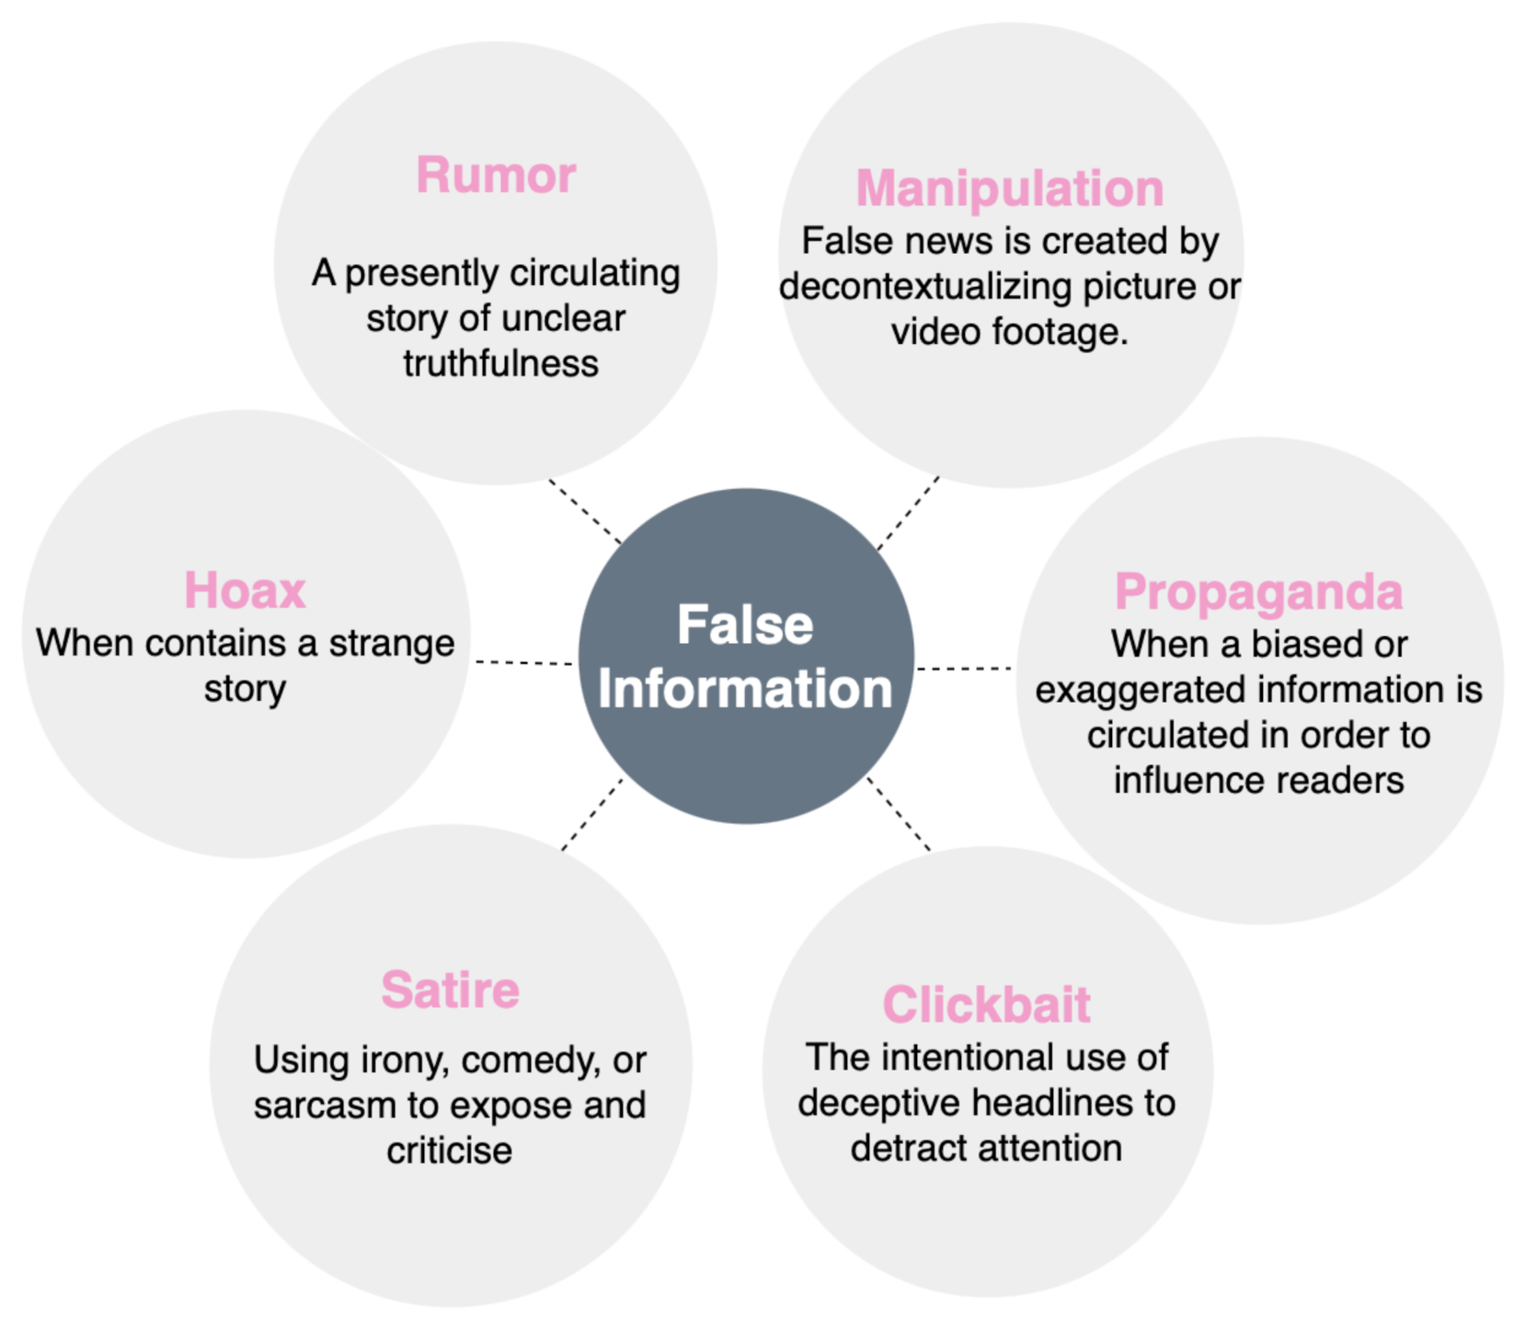
OBJECTIVE
To design a Fake news detection system that is efficient and analyze whether the information is real or fake.
The system also predicts the better performance model using machine learning algorithms.

Slide 5
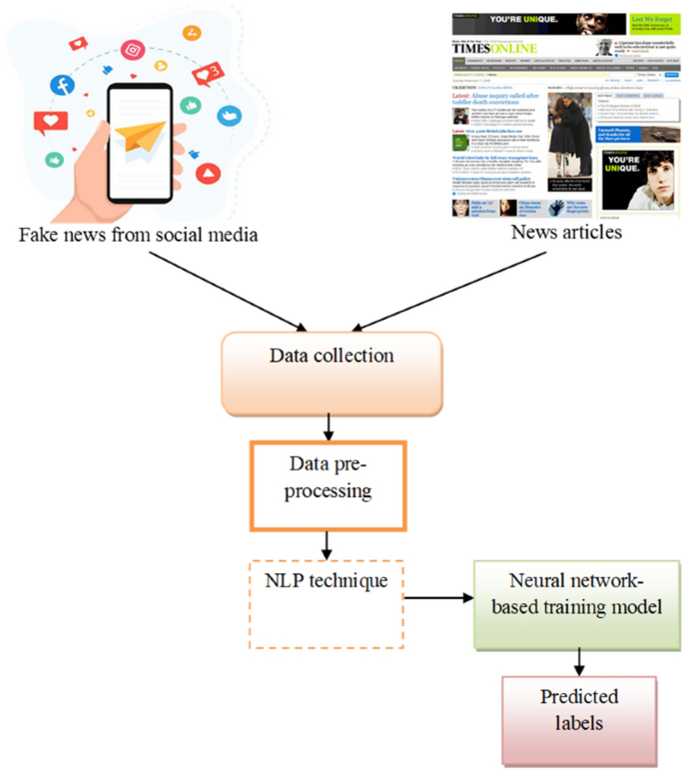
LITERATURE SURVEY
There are several algorithms for detecting the fake news.
For that we analyse through different classifiers in different research papers.
The classifiers are Random Forest, CNN, SVM, KNN, Logistic Regression, Naive Bayes, Long Short Term memory and SGD.
The accuracy obtained by using Random forest is 83 %, the accuracy obtained by using CNN is 97%, the accuracy obtained by using SVM is 94%, the accuracy obtained by using KNN is 79%, the accuracy obtained by using Logistic Regression is 97%, the accuracy obtained by using Naive Bayes is 90%, the accuracy obtained by using Long Short term memory is 97%, the accuracy obtaining by using the combination of SVM &NB is 78% and the accuracy obtained by using SGD is 77.2%. Compared to all CNN,LR and LSTM obtains high accuracy.

Slide 6
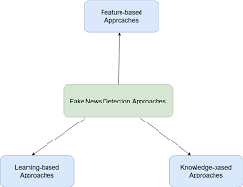
EXISTING SYSTEM
The existing system uses the Bayes classifier. Naïve Bayes Classifier: This classification technique is based on Bayes theorem, which assumes that the presence of a particular feature in a class is independent of the presence of any other feature.
It provides way for calculating the posterior probability.
EVALUATION
In simple terms, a Naive Bayes classifier assumes that the presence of a particular feature in a class is unrelated to the presence of any other feature.
P(A|B) = P(B|A) * P(A) / P(B)
Where the probability that we are interested in calculating P(A|B) is called the posterior probability and the marginal probability of the event P(A) is called the prior.

Slide 7
DRAWBACKS OF EXISTING SYSTEM
01
Some of the datasets are constructed only with political statements like PolitiFact, LIAR, Weibo, etc.
02
The major issue of fake news is inherently a multimodal and multilingual one, which consists of information in an array of languages, auditory, visual or textual forms, and generally involved in communication in a language that may be unfamiliar to users
03
The major problem in detecting fake news is the lack of a massive dataset and a labeled benchmark dataset with ground-truth labels.

Slide 8
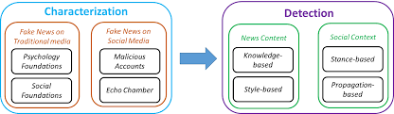
PROPOSED SYSTEM
In the proposed system we used three algorithms of machine learning like logistic regression, decision tree and random forest.
By static search part, we have trained and used three algorithms for classification.
They are decision tree, Random Forest and Logistic Regression.

Slide 9
ADVANTAGES
01
It is capable of handling large datasets with high dimensionality.
02
It enhances the accuracy of the model and prevents the overfitting issue.
03
Random Forest is capable of performing both Classification and Regression tasks.

Slide 10
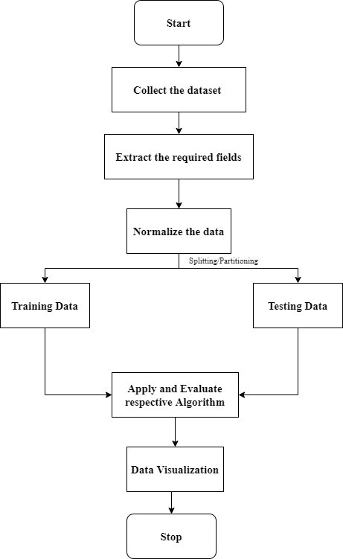
SYSTEM ARCHITECTURE
The preliminary level design specifies the architecture of the system.
The database needed for the system is designed first.
Then in the detail design, each component is defined in detail.
The role and function of each component is clearly defined.
Then pseudocode is developed for the system.
Finally hardware and software components required for implementing the system is to be identified.

Slide 11
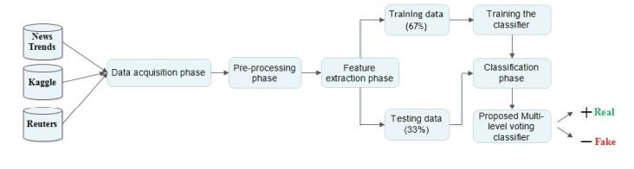
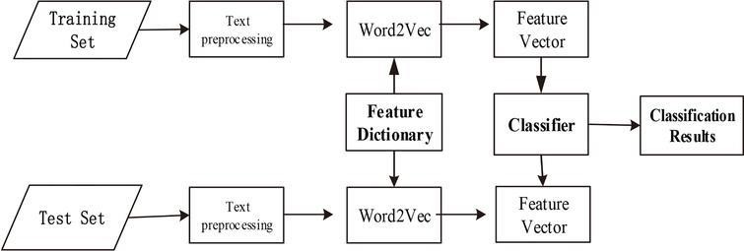
HIGH LEVEL ARCHITECTURE
LOW LEVEL ARCHITECTURE

Slide 12
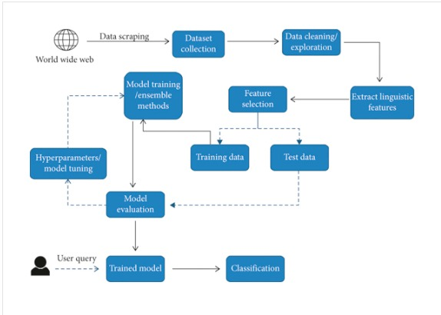
MODULES
Text Preprocessing
Feature Extraction
Feature Selection
Model Evaluation

Slide 13
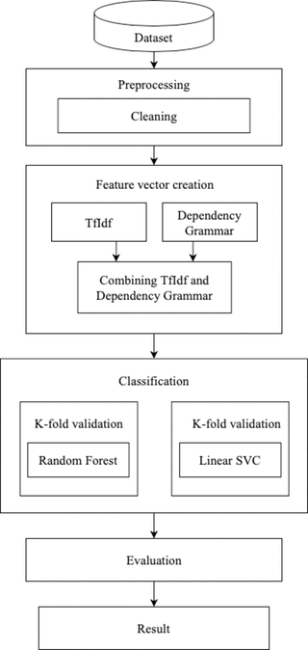
MODULES
Text Preprocessing This module focuses on cleaning and transforming raw text data to make it suitable for machine learning algorithms. It may involve tasks like tokenization, stop word removal, stemming or lemmatization, and removing special characters or punctuation.
Feature Extraction In this module, relevant features are extracted from the preprocessed text data. Some commonly used techniques include bag-of-words (BoW), term frequency-inverse document frequency (TF-IDF), word embeddings (e.g., Word2Vec or GloVe), or character-level n-grams.
Feature Selection To improve the efficiency and accuracy of the fake news detection model, feature selection techniques can be employed. These methods help identify the most informative and relevant features for classification. Common approaches include chi-square test, mutual information, or L1 regularization.
Model Evaluation This module is used to assess the performance of the fake news detection model. Evaluation metrics such as accuracy, precision, recall, and F1-score can be used to measure the effectiveness of the model.

Slide 14

HARDWARE ENVIRONMENT
Processor - Intel Core 3 Duo
Speed - 2.6 GHz
RAM - 4 GB RAM
Hard Disk - 100 GB
SOFTWARE ENVIRONMENT
Anaconda
Jupyter Notebook
Python libraries
Keras
Tensorflow

Slide 15
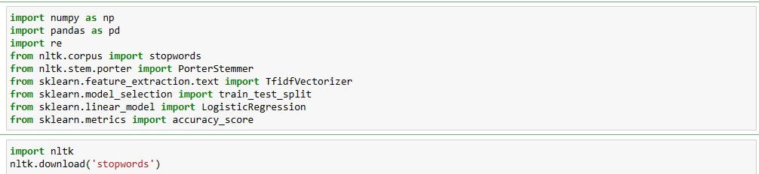
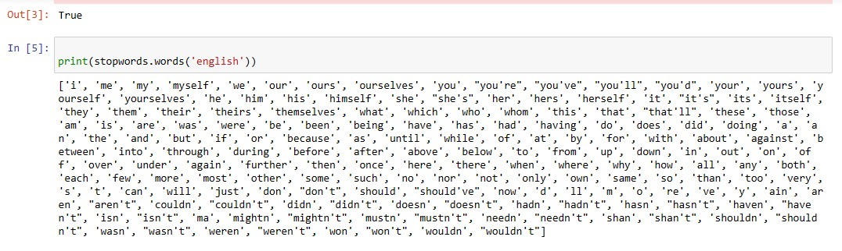
SCREEN SHOTS

Slide 16
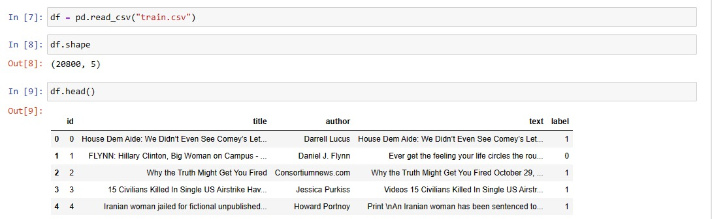
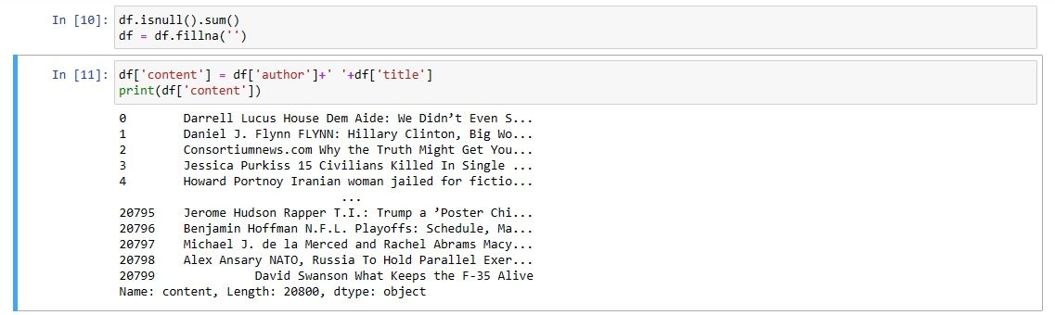

Slide 17
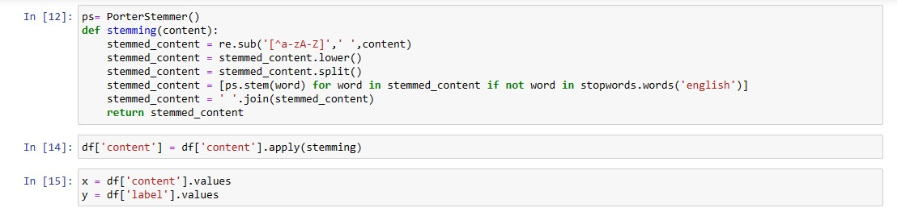
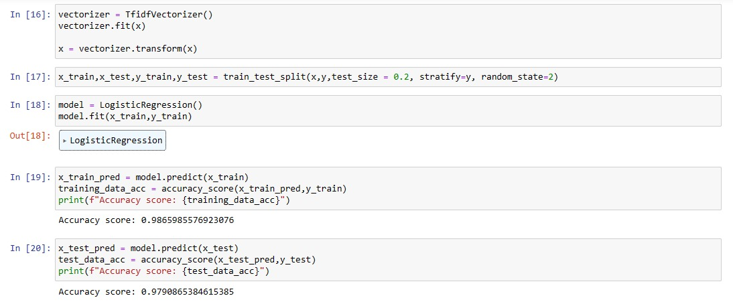

Slide 18

CONCLUSION
The growing problem of fake news only makes things more complicated and tries to change or hamper the opinion and attitude of people towards use of digital technology.
Thus, in order to curb the phenomenon, we have developed our Fake news Detection system that takes input from the user and classify it to be true or fake.
In this project , various Machine Learning Techniques like Logistic Regression, Decision Tree Classifier and Random Forest Classifier are analyzed.
The model is trained using an appropriate dataset and performance evaluation is also done using various performance measures.
The best model, i.e. the model with highest accuracy is used to classify the news headlines or articles. Our best model came out to be Decision Tree with an accuracy of 99.65%.

Slide 19


